Slide 1
College Admission Management System Developed in PHP & MySQL

Slide 2
Introduction
Today all the work at the time of admission of the students is done manually by ink and paper, which is very slow and consuming much efforts and time. In the modern world of technology, computer are affecting our lives in more ways than we probably are aware of COMPUTERIZED MANAGEMENT maintaining information of an educational institute, colleges, other the list is endless. The main principle behind the need of college admission system is easy supervision of institutes. It can handle the details of students such as personal details or admission details. This Student Database has been designed taking into account the practical needs to manage a Students data. Moreover, it provides security at product level as well as user level. Its design concentrates on 2 types of users:
Admin
Students

Slide 3
Admin Module
Dashboard: In this section, the admin can see all the detail in brief.
Reg Users: In this section, the admin can view user detail, delete and update user detail.
Admission Application: In this section, admin can view all applications. Admin can view applications and documents on the basis of status(pending application, approved an application, and reject application). Admin also can approve the pending application. (Whenever the admin changes the status of the application user will get an email notification). Note: The email function will not work in localhost.
Search Application: In this section, admin can search applications on the basis of user name, email id, and contact number.
Course: In this section, admin can manage courses(add, delete and update).
Notice: In this section, admin can manage notice(add and update) and anybody see this notice on the website.
Notification: In this section, admin gets the notification if any user applies for admission.
Pages: In this section, Admin can manage the content of the about us and contact us page.
Subscribers: In this action , admin can view the subscriber list.
Reports: In this section, admin can generate the report b/w dates.

Slide 4
User/Student Module
User can contact the administrator by sending mails.
User can view the about us and contact us page.
User can view notices which are published by the admin.
User can view courses that are listed by the admin.
User can register themselves.
After User/Student Login
1.Dashboard: In this section, user can see the status of his application.
2.Admission Form: In this section, user can fill the form and check his / her application form is selected or rejected(which is done by admin).
3.Submit Fees: In this section, If user/student application is selected user can submit their fees.
A user can also update his/ her profile, change the password and recover the password.

Slide 5
GOALS
The main goal of the system is to automate the process carried out in the organization with improved performance and realize the vision of paperless admission. Some of the goals of the system are listed below:
Manage large number of student details.
Manage all details of student who registered for the course and send appropriate details about the course to the students account.
Create student accounts and maintain the data’s effectively.
View all the details of the students.
Create the statistical reports.
Reduce the work load in interview the students for selection and Counseling should be very effective rather than direct methods.

Slide 6
Requirement Specification
Hardware Configuration:
Client Side
Server Side
RAM | 512 MB
Hard Disk | 10GB
Processor | 1.0 GHz
RAM | 1 GB
Hard Disk | 20GB
Processor | 2.0GHz

Slide 7
Continue.....
Software Requirement:
Client Side
Server Side
Web Browser | Google Chrome or any compatible browser
Operating System | Windows or any equivalent OS
Web Server | APACHE
Server side Language | PHP5.6 or above version
Database Server | MySQL
Web Browser | Google Chrome or any compatible browser
Operating System | Windows or any equivalent OS

Slide 8
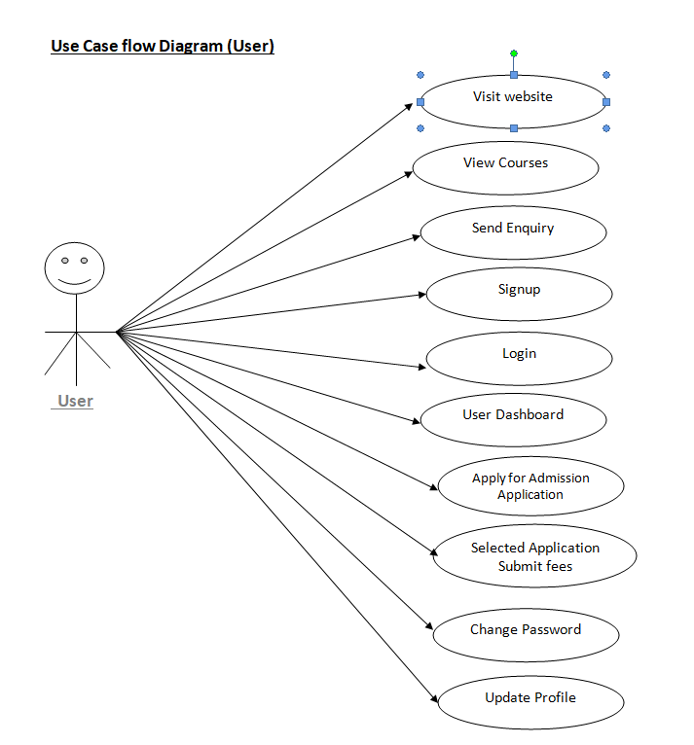
Use Case Diagram
Notes:
USECASE DIAGRAM: A Use case is a description of set of sequence of actions. Graphically it is rendered as an ellipse with solid line including only its name. Use case diagram is a behavioral diagram that shows a set of use cases and actors and their relationship. It is an association between the use cases and actors. An actor represents a real-world object. Primary Actor – Sender, Secondary Actor Receiver.

Slide 9
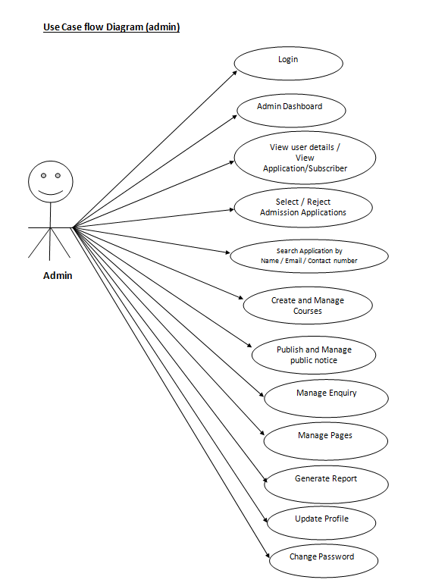
Continue.......

Slide 10
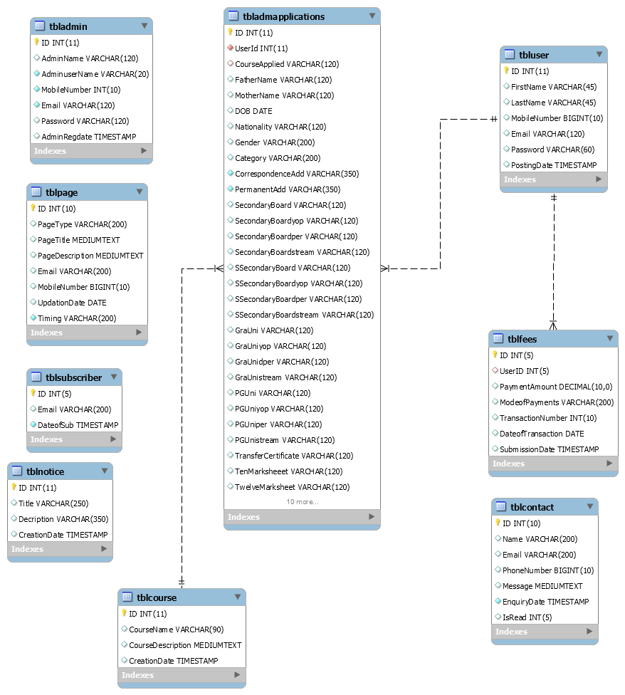
Class / Schema Diagram
Notes:
Class Diagram:
A description of set of objects that share the same attributes operations, relationships, and semantics

Slide 11
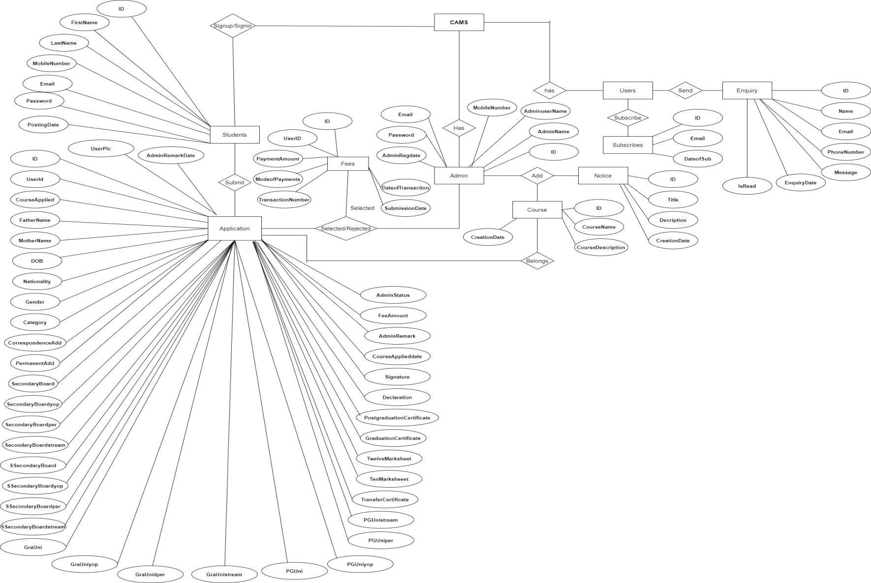
ER Diagram

Slide 12
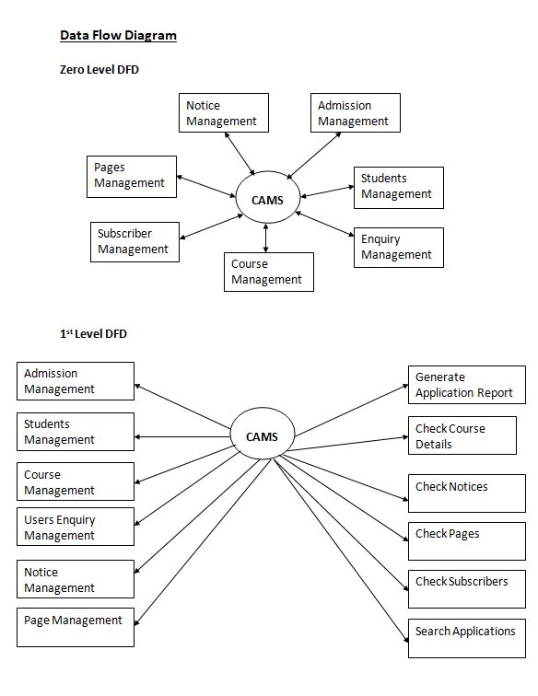
DFD (Data Flow Diagram)

Slide 13
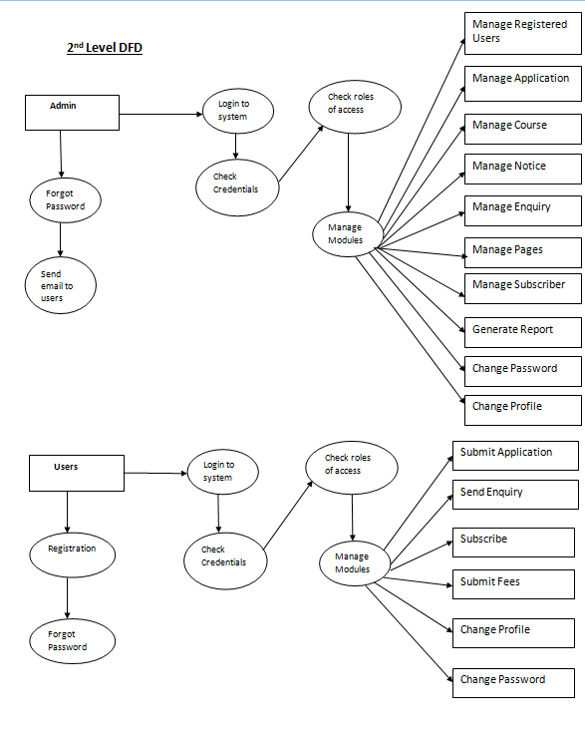

Slide 14
Implementation and System Testing
After all phase have been perfectly done, the system will be implemented to the server and the system can be used.
System Testing
The goal of the system testing process was to determine all faults in our project .The program was subjected to a set of test inputs and many explanations were made and based on these explanations it will be decided whether the program behaves as expected or not. Our Project went through two levels of testing
Unit testing
Integration testing

Slide 15

Project Screens

Slide 16
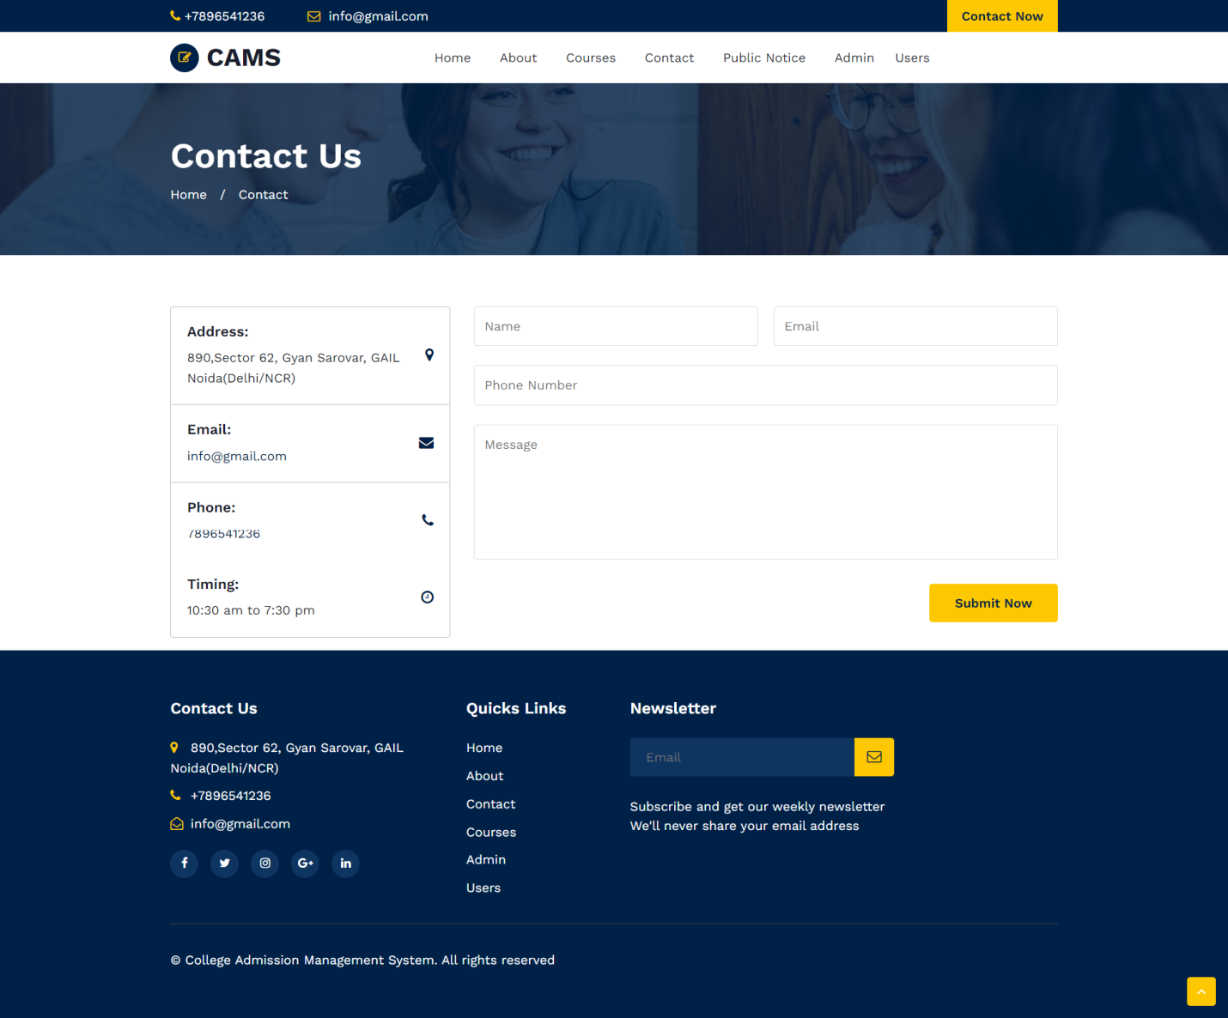

Slide 17


Slide 18
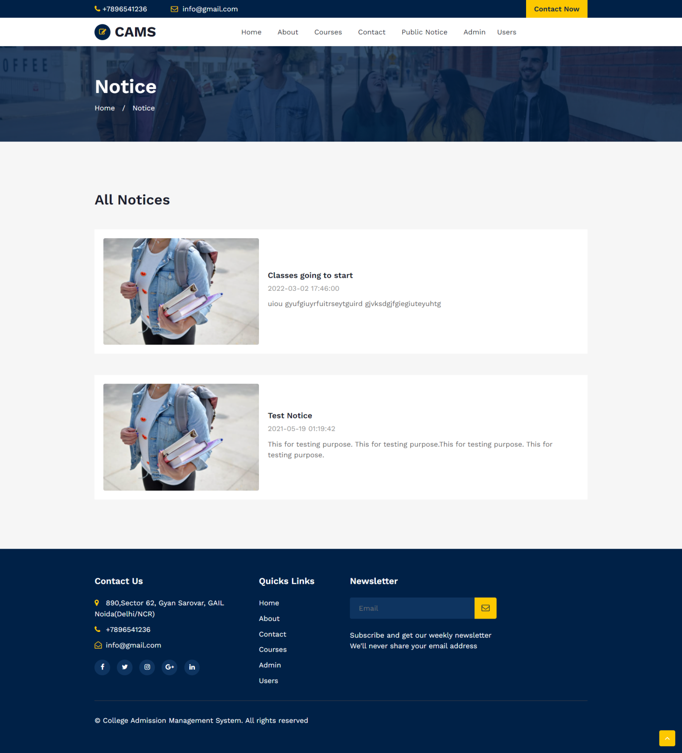

Slide 19
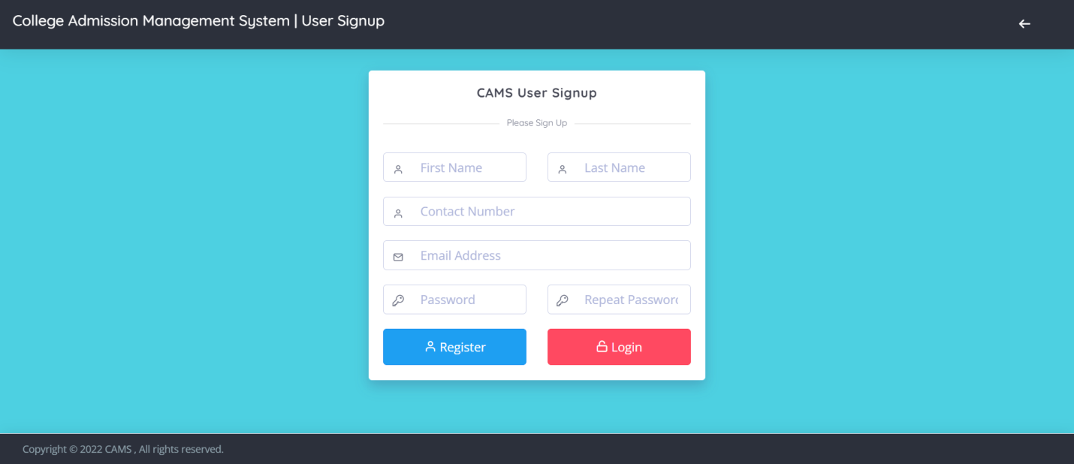
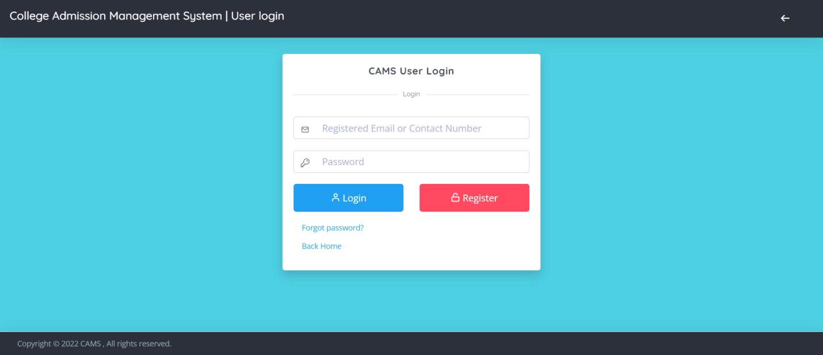

Slide 20
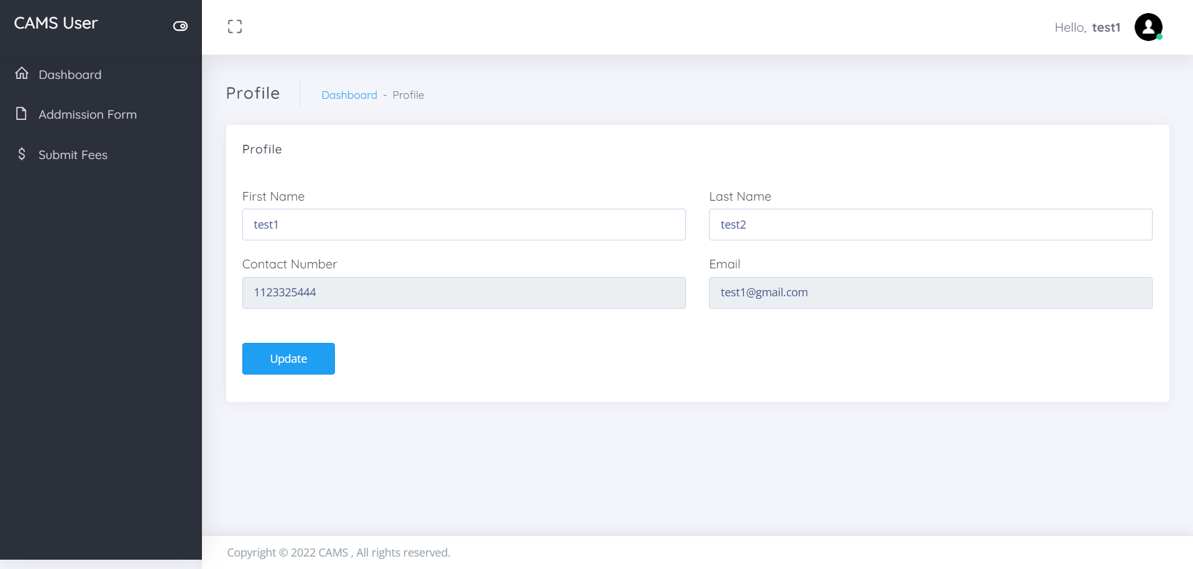
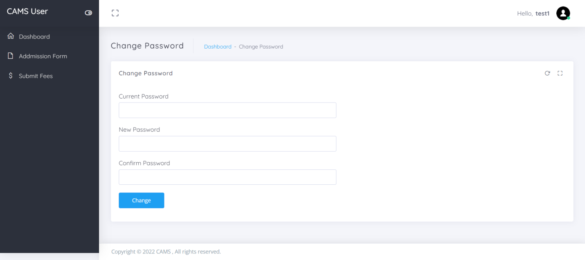

Slide 21
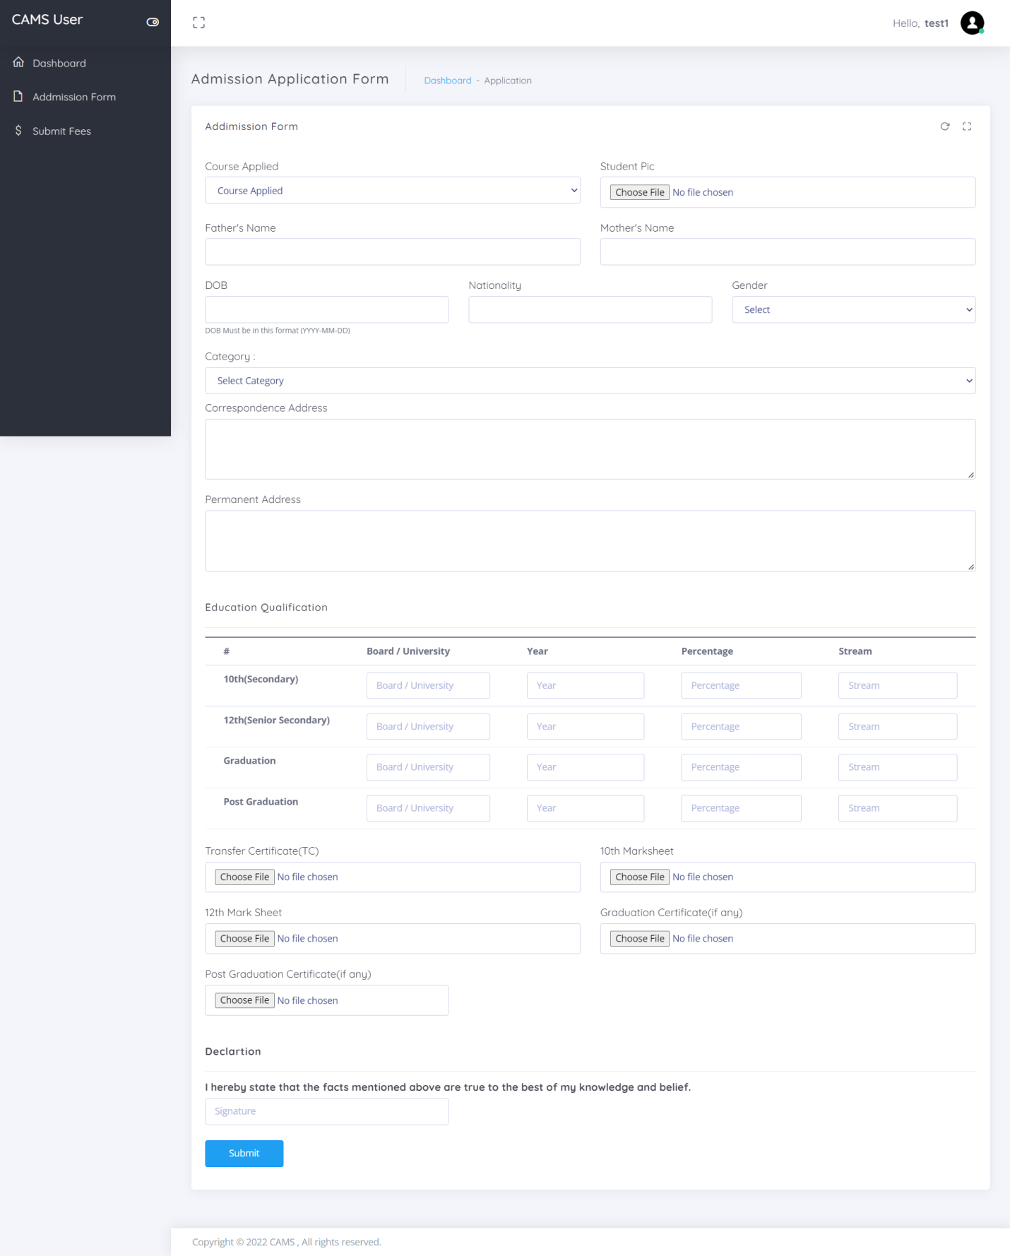

Slide 22
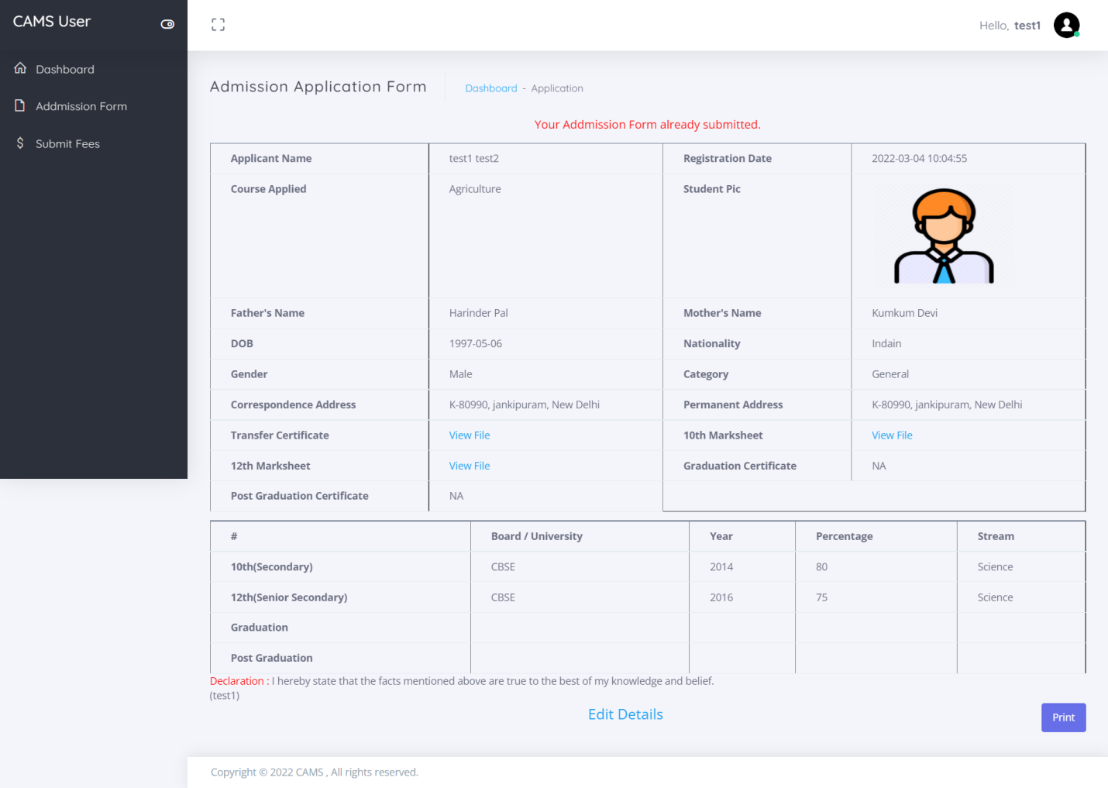
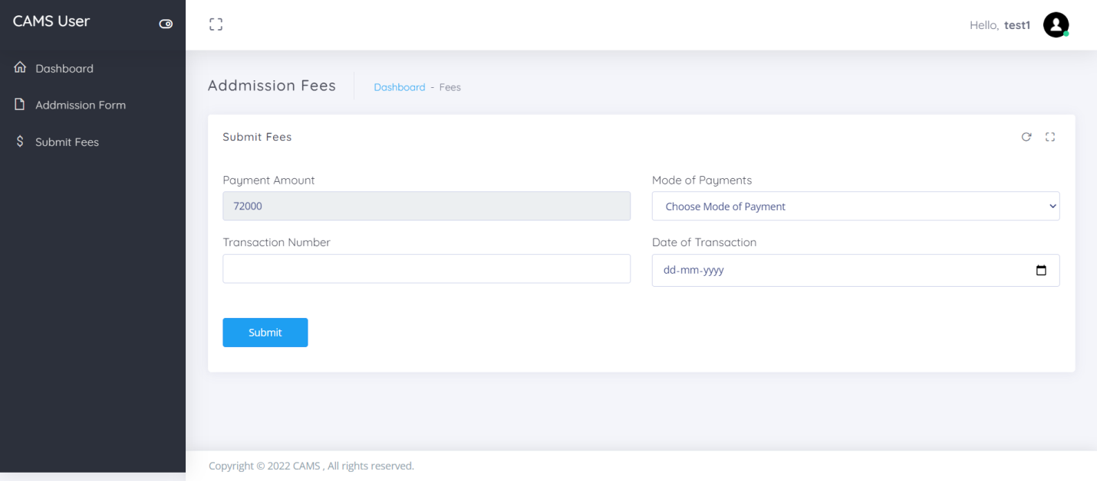

Slide 23
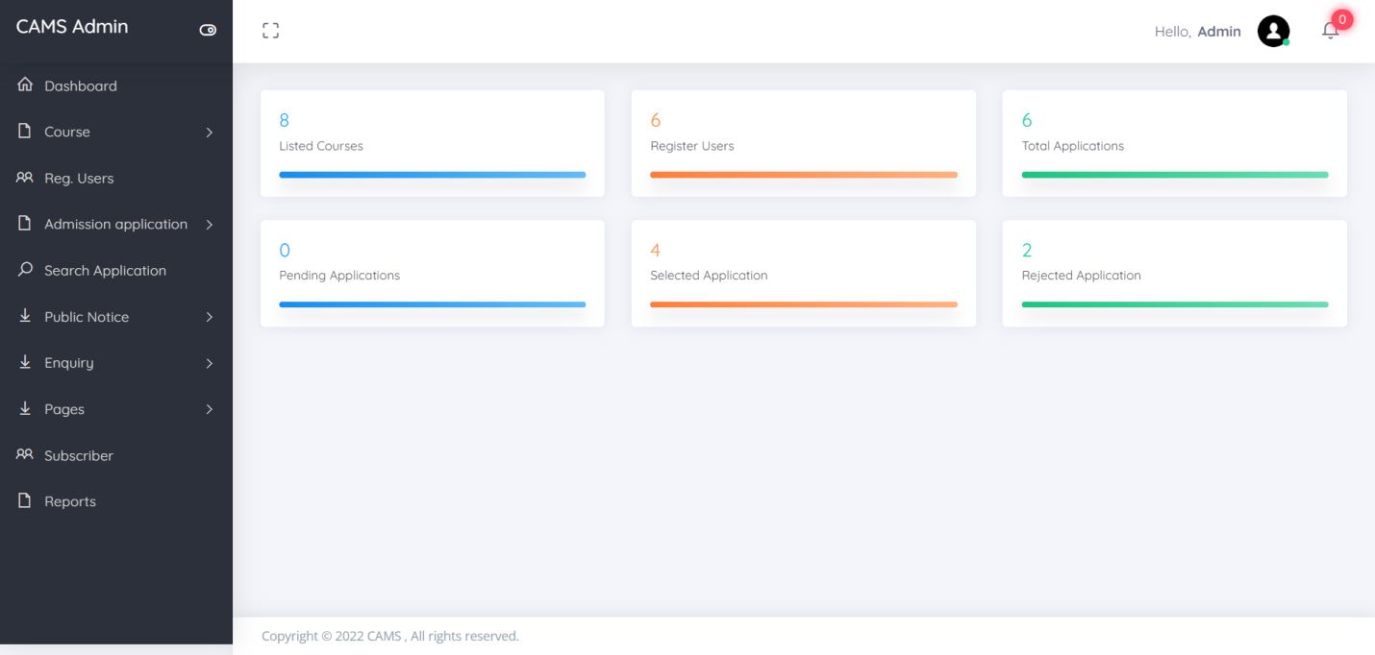
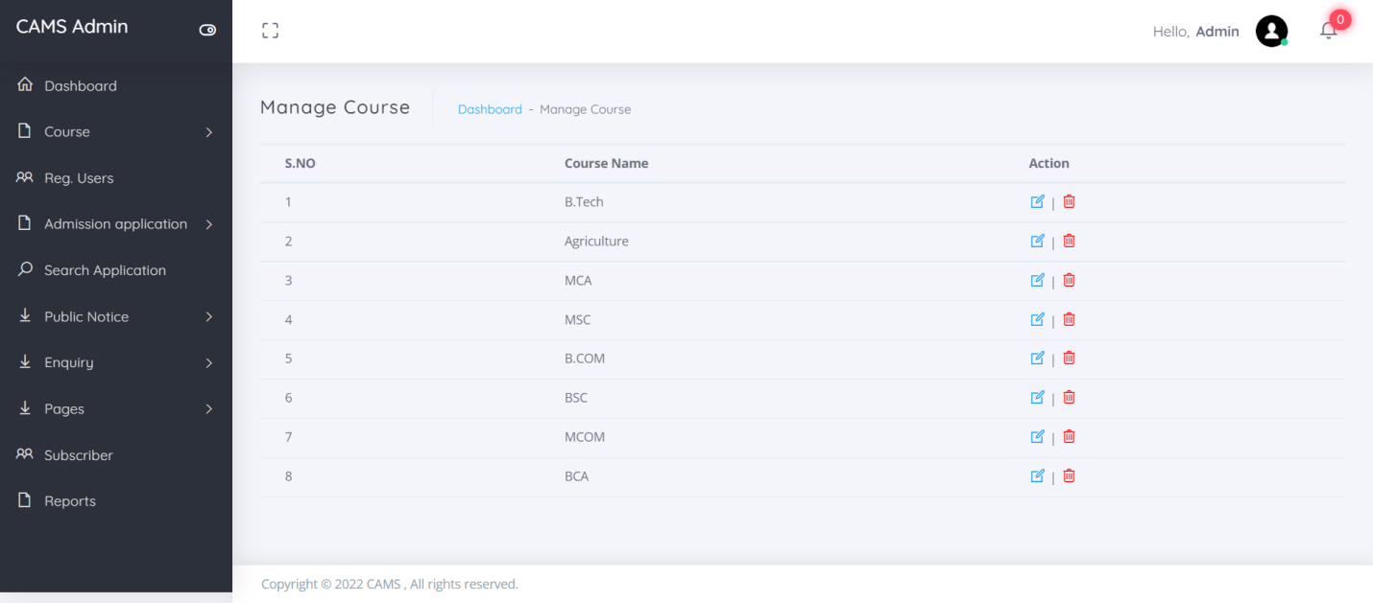

Slide 24
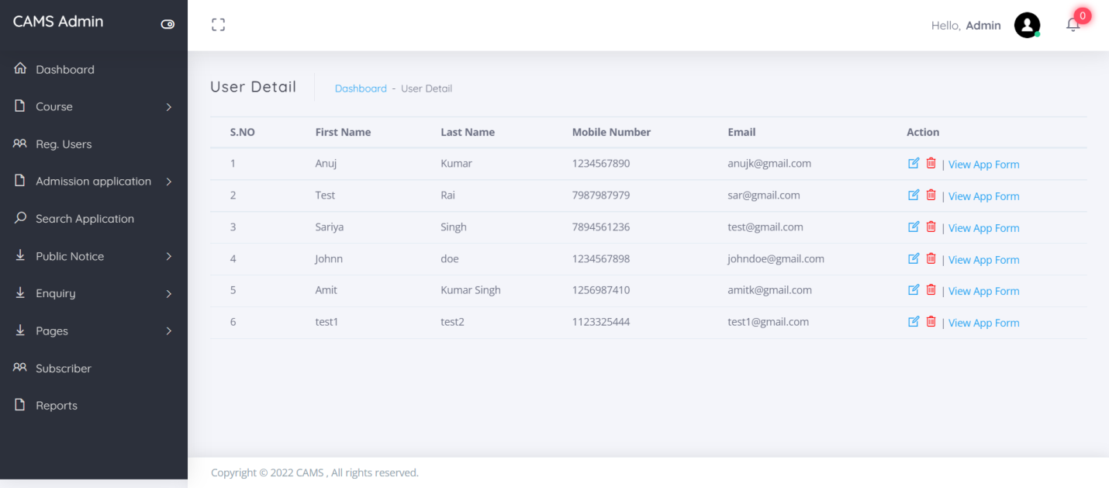
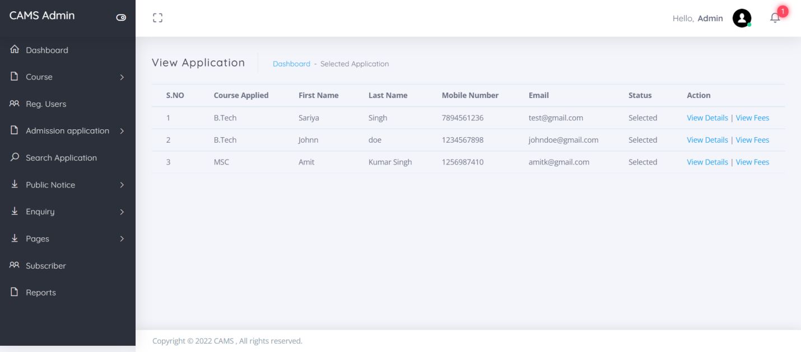

Slide 25
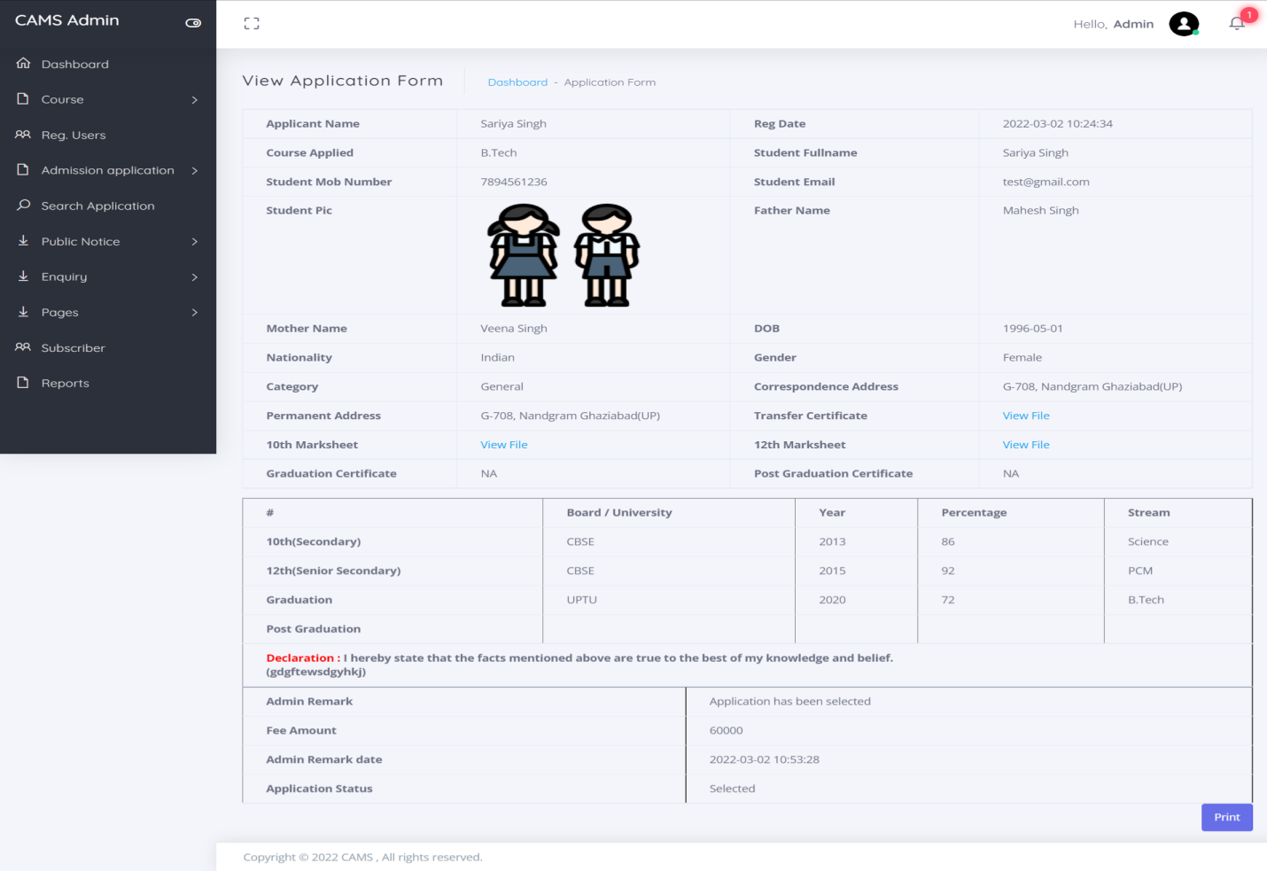

Slide 26
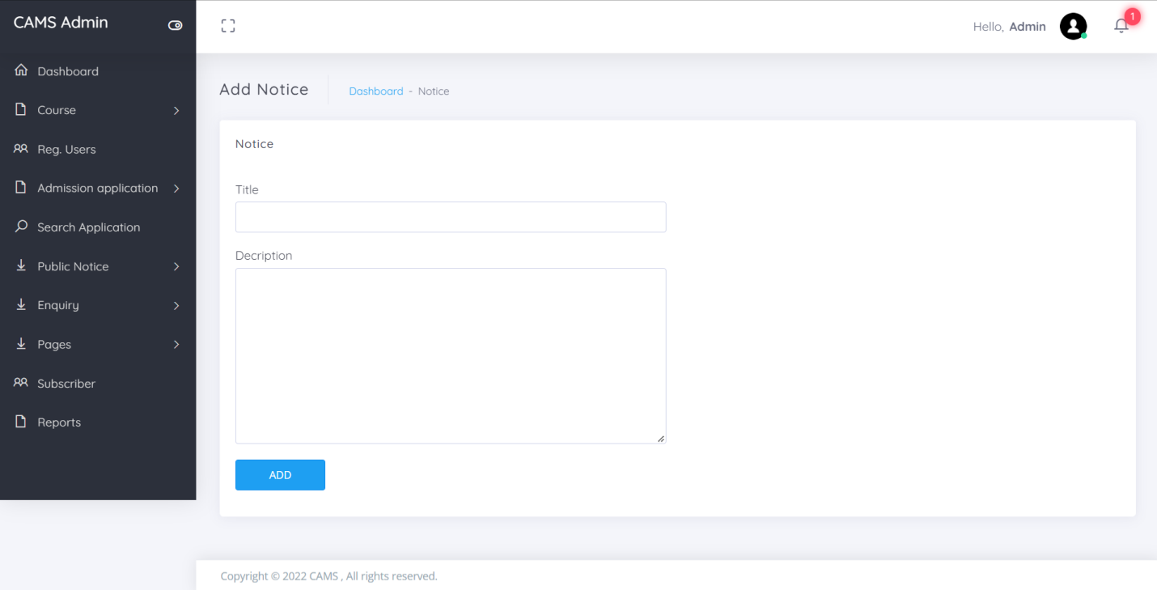
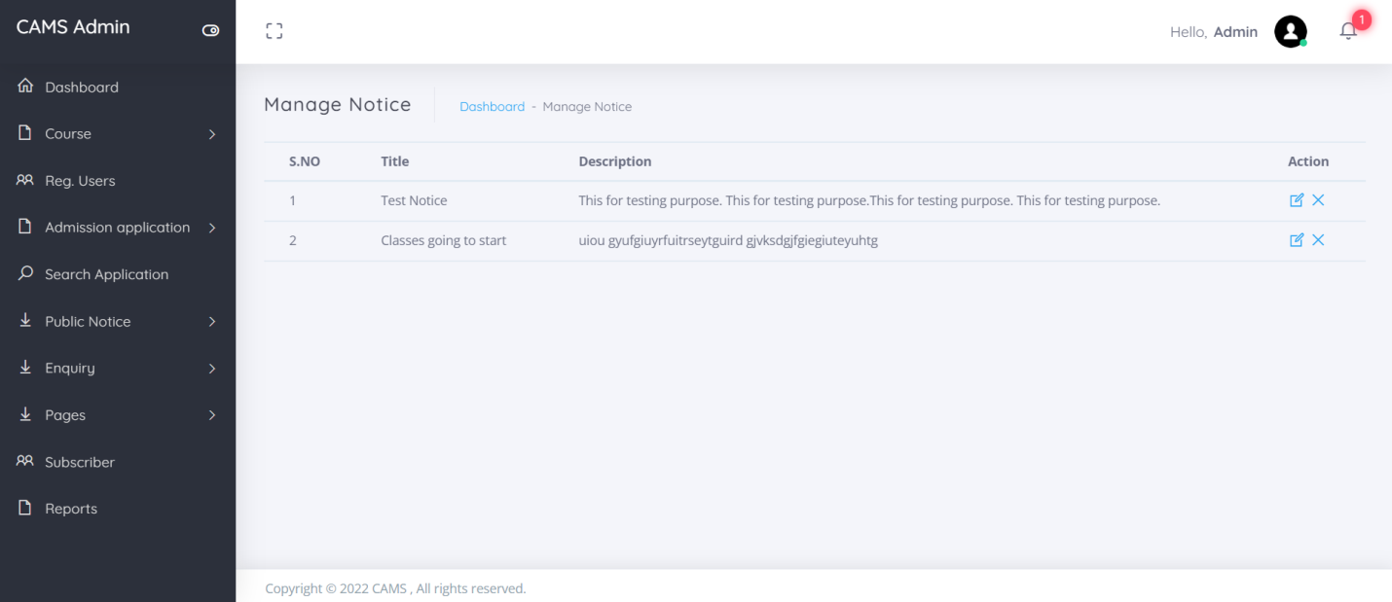

Slide 27
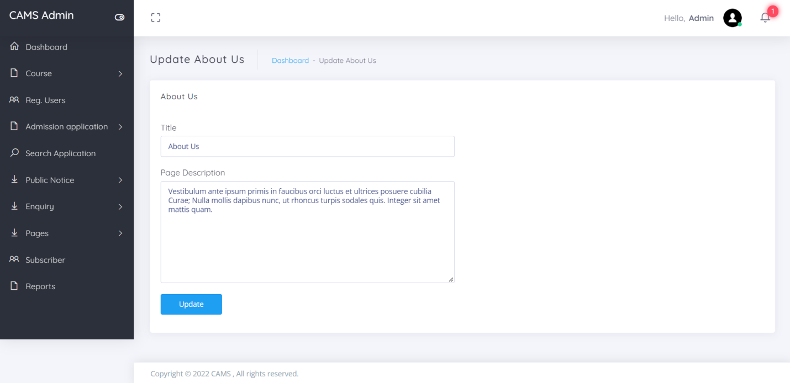
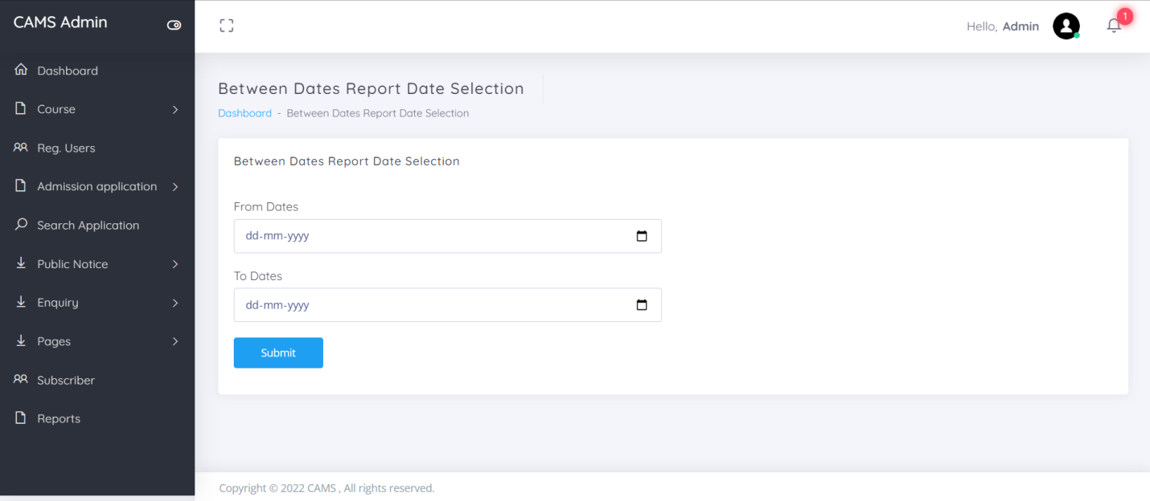

Slide 28
Conclusion
In this way we are going to develop college admission system, which is helpful for Reduction in manual work so less manpower required. Students’ records can be accessed within few seconds, Clarity in account section. Our system primarily focuses on building an efficient and user friendly communication system for the educational institutions.

Slide 29
References
For PHP
https://www.w3schools.com/php/default.asp
https://www.sitepoint.com/php/
https://www.php.net/
For MySQL
https://www.mysql.com/
http://www.mysqltutorial.org
For XAMPP
https://www.apachefriends.org/download.html

Slide 30
Thank You

